Slide 1
Pattern Clustering: Introduction
Some slides from: Dr. Carla Brodley, Tufts University

Slide 2
What is Cluster Analysis?
Finding groups of objects such that the objects in a group will be similar (or related) to one another and different from (or unrelated to) the objects in other groups
Inter-cluster distances are maximized
Intra-cluster distances are minimized

Slide 3
Why cluster?
Labeling is expensive
Gain insight into the structure of the data
Find prototypes in the data
Notes:
Until now we have assumed that the training data is labeled.
Now we look at what can we do with data when we have not labels.
\item Example: group customer behavior, find similar buying patterns.

Slide 4
Goal of Clustering
Given a set of data points, each described by a set of attributes, find clusters such that:
Inter-cluster similarity is
maximized
Intra-cluster similarity is
minimized
Requires the definition of a similarity measure
F1
x
x
x
x
x
x
x
x
xx
x
x
x
x
x
x
xx
x
F2
Notes:
Data

Slide 5
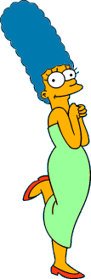



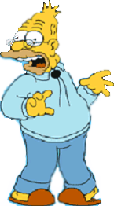
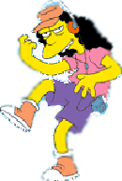



What is a natural grouping of these objects?
Slide from Eamonn Keogh

Slide 6



What is a natural grouping of these objects?
Slide from Eamonn Keogh
Clustering is subjective
Simpson's Family
School Employees
Females
Males

Slide 7
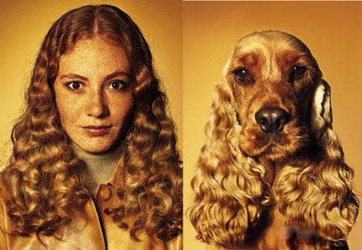
What is Similarity?
Slide based on one by Eamonn Keogh
Similarity is hard to define, but…
“We know it when we see it”

Slide 8
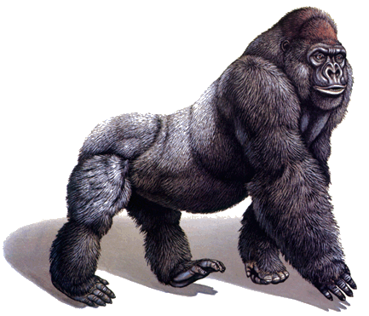
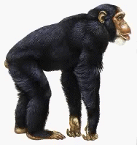
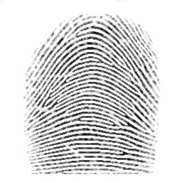
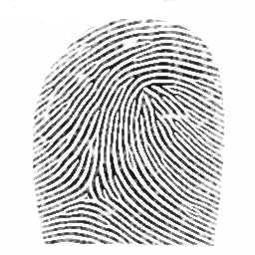
Defining Distance Measures
Slide from Eamonn Keogh
Definition: Let O₁ and O₂ be two objects from the universe of possible objects. The distance (dissimilarity) between O₁ and O₂ is a real number denoted by D(O₁,O₂)
Peter
Piotr
0.23
3
342.7

Slide 9
Slide based on one by Eamonn Keogh
What properties should a distance measure have?
D(A,B) = D(B,A) Symmetry
D(A,A) = 0 Constancy of Self-Similarity
D(A,B) = 0 iif A= B Positivity (Separation)
D(A,B) ≤ D(A,C) + D(B,C) Triangular Inequality

Slide 10
Slide based on one by Eamonn Keogh
Intuitions behind desirable distance measure properties
D(A, B) = D(B, A)
Otherwise you could claim “Alex looks like Bob, but Bob looks nothing like Alex.”
D(A, A) = 0
Otherwise you could claim “Alex looks more like Bob, than Bob does.”

Slide 11
Slide based on one by Eamonn Keogh
Intuitions behind desirable distance measure properties (continued)
D(A,B) = 0 IIf A=B
Otherwise there are objects in your world that are different, but you cannot tell apart.
D(A,B) ≤ D(A,C) + D(B,C)
Otherwise you could claim “Alex is very like Bob, and Alex is very like Carl, but Bob is very unlike Carl.”

Slide 12


Two Types of Clustering
Slide based on one by Eamonn Keogh
Partitional algorithms: Construct various partitions and then evaluate them by some criterion
Hierarchical algorithms: Create a hierarchical decomposition of the set of objects using some criterion
Hierarchical
Partitional
Notes:
Have class break into groups and invent clustering algorithms.

Slide 13
Dendogram: A Useful Tool for Summarizing Similarity Measurements
Slide based on one by Eamonn Keogh
The similarity between two objects in a dendrogram is represented as the height of the lowest internal node they share.

Slide 14
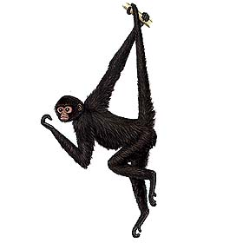
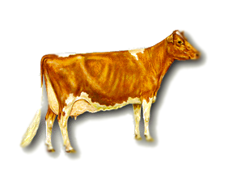
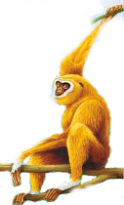
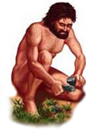
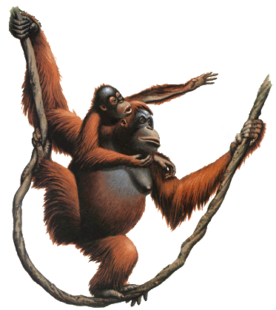
Slide based on one by Eamonn Keogh
There is only one dataset that can be perfectly clustered using a hierarchy…
(Bovine:0.69395, (Spider Monkey 0.390, (Gibbon:0.36079,(Orang:0.33636,(Gorilla:0.17147,(Chimp:0.19268, Human:0.11927):0.08386):0.06124):0.15057):0.54939);

Slide 15
A demonstration of hierarchical clustering using string edit distance
Slide based on one by Eamonn Keogh
Piotr
Peder
Pyotr
Pedro
Piero
Peter
Peka
Mick
Pietro
Pierre
Petros
Peadar
Miguel
Krystof
Michael
Michalis
Crisdean
Cristovao
Christoph
Cristobal
Kristoffer
Christophe
Cristoforo
Christopher

Slide 16











Slide based on one by Eamonn Keogh
Hierarchal clustering can sometimes show patterns that are meaningless or spurious
The tight grouping of Australia, Anguilla, St. Helena etc is meaningful; all these countries are former UK colonies
However the tight grouping of Niger and India is completely spurious; there is no connection between the two.
South Georgia &
South Sandwich
Islands
Serbia &
Montenegro
(Yugoslavia)
AUSTRALIA
St. Helena &
Dependencies
ANGUILLA
U.K.
FRANCE
NIGER
INDIA
IRELAND
BRAZIL

Slide 17
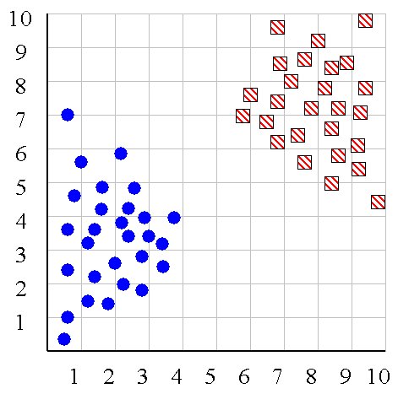
Slide based on one by Eamonn Keogh
We can look at the dendrogram to determine the “correct” number of clusters.
Notes:
In this case, the two highly separated subtrees are highly suggestive of two clusters. (Things are rarely this clear cut, unfortunately)

Slide 18
Slide based on one by Eamonn Keogh
One potential use of a dendrogram: detecting outliers
The single isolated branch is suggestive of a data point that is very different to all others
Outlier

Slide 19
Hierarchical Clustering
Slide based on one by Eamonn Keogh
The number of dendrograms with n leafs = (2n -3)!/[(2^{(n -2)}) (n -2)!]
Number Number of Possible
of Leafs Dendrograms
2 1
3 3
4 15
5 105
... …
34,459,425
Since we cannot test all possible trees we will have to heuristic search of all possible trees. We could do this..
Bottom-Up (agglomerative): Starting with each item in its own cluster, find the best pair to merge into a new cluster. Repeat until all clusters are fused together.
Top-Down (divisive): Starting with all the data in a single cluster, consider every possible way to divide the cluster into two. Choose the best division and recursively operate on both sides.

Slide 20


Slide based on one by Eamonn Keogh
We begin with a distance matrix which contains the distances between every pair of objects in our database.
0
8
8
7
7
0
2
4
4
D( , ) = 8
D( , ) = 1
0
3
3
0
1
0

Slide 21
Bottom-Up (agglomerative): Starting with each item in its own cluster, find the best pair to merge into a new cluster. Repeat until all clusters are fused together.
This slide and next 4 based on slides by Eamonn Keogh
Consider all possible merges…
Choose the best
…

Slide 22
Bottom-Up (agglomerative): Starting with each item in its own cluster, find the best pair to merge into a new cluster. Repeat until all clusters are fused together.
Consider all possible merges…
Choose the best
…
Consider all possible merges…
Choose the best
…

Slide 23
Bottom-Up (agglomerative): Starting with each item in its own cluster, find the best pair to merge into a new cluster. Repeat until all clusters are fused together.
Consider all possible merges…
Choose the best
…
Consider all possible merges…
Choose the best
…
Consider all possible merges…
Choose the best
…

Slide 24
Bottom-Up (agglomerative): Starting with each item in its own cluster, find the best pair to merge into a new cluster. Repeat until all clusters are fused together.
Consider all possible merges…
Choose the best
…
Consider all possible merges…
Choose the best
…
Consider all possible merges…
Choose the best
…

Slide 25
Linkage Methods of Clustering
Single Linkage
Minimum Distance
Cluster 1
Cluster 2
Complete Linkage
Maximum Distance
Cluster 1
Cluster 2
Average Linkage
Average Distance
Cluster 1
Cluster 2

Slide 26
Slide based on one by Eamonn Keogh
We know how to measure the distance between two objects, but defining the distance between an object and a cluster, or defining the distance between two clusters is non obvious.
Single linkage (nearest neighbor): In this method the distance between two clusters is determined by the distance of the two closest objects (nearest neighbors) in the different clusters.
Complete linkage (furthest neighbor): In this method, the distances between clusters are determined by the greatest distance between any two objects in the different clusters (i.e., by the "furthest neighbors").
Group average linkage: In this method, the distance between two clusters is calculated as the average distance between all pairs of objects in the two different clusters.

Slide 27
Slide based on one by Eamonn Keogh
Single linkage
Average linkage

Slide 28
Slide based on one by Eamonn Keogh
Hierarchal Clustering Methods Summary
No need to specify the number of clusters in advance
Hierarchal nature maps nicely onto human intuition for some domains
They do not scale well: time complexity of at least O(n²), where n is the number of total objects
Like any heuristic search algorithms, local optima are a problem
Interpretation of results is (very) subjective

Slide 29







Slide based on one by Eamonn Keogh
Partitional Clustering
Nonhierarchical, each instance is placed in exactly one of K non-overlapping clusters.
Since only one set of clusters is output, the user normally has to input the desired number of clusters K.

Slide 30
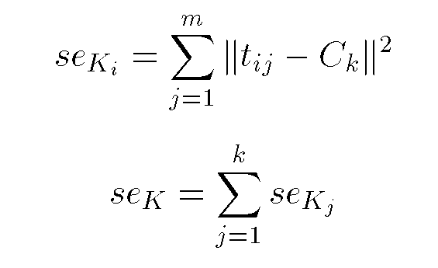
Squared Error
Slide based on one by Eamonn Keogh
10
9
8
7
6
5
4
3
2
1
1
2
3
4
5
6
7
8
9
10
Objective Function

Slide 31
Types of Clusters: Objective Function
Clusters Defined by an Objective Function
Finds clusters that minimize or maximize an objective function.
Enumerate all possible ways of dividing the points into clusters and evaluate the `goodness' of each potential set of clusters by using the given objective function. (No. of feasible partitions could be very large and the problem is NP Hard)
Can have global or local objectives.
Hierarchical clustering algorithms typically have local objectives
Partitional algorithms typically have global objectives
A variation of the global objective function approach is to fit the data to a parameterized model.
Parameters for the model are determined from the data.
Mixture models assume that the data is a ‘mixture' of a number of statistical distributions.

Slide 32
Types of Clusters: Objective Function …
Map the clustering problem to a different domain and solve a related problem in that domain
Proximity matrix defines a weighted graph, where the nodes are the points being clustered, and the weighted edges represent the proximities between points
Clustering is equivalent to breaking the graph into connected components, one for each cluster.
Want to minimize the edge weight between clusters and maximize the edge weight within clusters

Slide 33
Membership matrix M
cluster centre i
cluster centre j
data point k
distance

Slide 34
c-partition
All clusters C together fills the whole universe U
Clusters do not overlap
A cluster C is never empty and it is smaller than the whole universe U
There must be at least 2 clusters in a c-partition and at most as many as the number of data points K

Slide 35
Objective Functions: Hard and Fuzzy C Means
Minimise the total sum of all distances

Slide 36
K-Means Type Clustering Algorithms
Given k, the k-means algorithm consists of four steps:
Select initial representative points (means or centroids) at random.
Assign each object to the cluster with the nearest centroid.
Compute each centroid as the mean of the objects assigned to it.
Repeat previous 2 steps until no change.

Slide 37
The Objective Function of K-Means
Most common measure is Sum of Squared Error (SSE) or summed Intra Cluster Spread (ICS)
For each point, the error is the distance to the nearest cluster center
To get SSE, we square these errors and sum them.
X_{i} is a data point in cluster C_{j} and c_{j} is the representative point (most often the mean) for cluster C_{j} .
Given two clusters, we can choose the one with the smallest error
One easy way to reduce SSE is to increase k, the number of clusters
A good clustering with smaller k can have a higher SSE than a poor clustering with higher k

Slide 38
Slide based on one by Eamonn Keogh
Partition Algorithm 1: k-means
1. Decide on a value for k.
2. Initialize the k cluster centers (randomly, if necessary).
3. Decide the class memberships of the N objects by assigning them to the nearest cluster center.
4. Re-estimate the k cluster centers, by assuming the memberships found above are correct.
5. If none of the N objects changed membership in the last iteration, exit. Otherwise goto 3.

Slide 39
K-means Clustering: Step 1
Algorithm: k-means, Distance Metric: Euclidean Distance
5
4
k₁
3
k₂
2
1
k₃
0
0
1
2
3
4
5
Slide based on one by Eamonn Keogh

Slide 40
K-means Clustering: Step 2
Algorithm: k-means, Distance Metric: Euclidean Distance
5
4
k₁
3
k₂
2
1
k₃
0
0
1
2
3
4
5
Slide based on one by Eamonn Keogh

Slide 41
K-means Clustering: Step 3
Algorithm: k-means, Distance Metric: Euclidean Distance
5
4
k₁
3
2
k₃
k₂
1
0
0
1
2
3
4
5
Slide based on one by Eamonn Keogh

Slide 42
K-means Clustering: Step 4
Algorithm: k-means, Distance Metric: Euclidean Distance
5
4
k₁
3
2
k₃
k₂
1
0
0
1
2
3
4
5
Slide based on one by Eamonn Keogh

Slide 43
K-means Clustering: Step 5
Algorithm: k-means, Distance Metric: Euclidean Distance
k₁
k₂
k₃
Slide based on one by Eamonn Keogh

Slide 44
Two different K-means Clustering
Original Points
Optimal Clustering
Sub-optimal Clustering

Slide 45
Importance of Choosing Initial Centroids

Slide 46
Importance of Choosing Initial Centroids

Slide 47
Importance of Choosing Initial Centroids …

Slide 48
Importance of Choosing Initial Centroids …

Slide 49
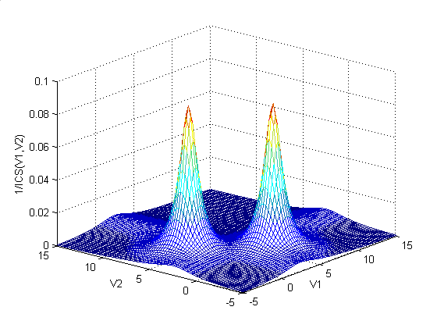
Landscape for Clustering Problem
The k-means objective function
Example of an extremely
simple one-dimensional dataset
Fitness function (Reciprocal of ICS)
plot of the hard c-means algorithm
for above dataset

Slide 50
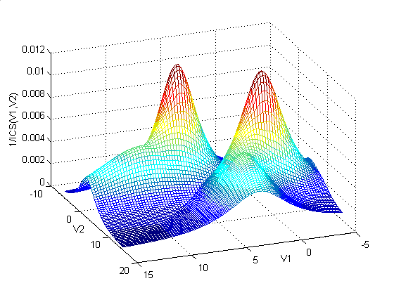
Landscape for Clustering Problem (Contd.)
The previous data but now
With some noise points
Fitness function (Reciprocal of ICS)
plot of the hard c-means algorithm
for above dataset
In addition to two global minima, we have local minima at: approximately (0, 10),
(5, 10), (10, 0), (10, 5). For these local minima one prototype covers one of the
data clusters, while the other prototype is mislead to the noise cluster.

Slide 51
Limitations of K-means
K-means has problems when clusters are of differing
Sizes
Densities
Non-globular shapes
K-means has problems when the data contains outliers.

Slide 52
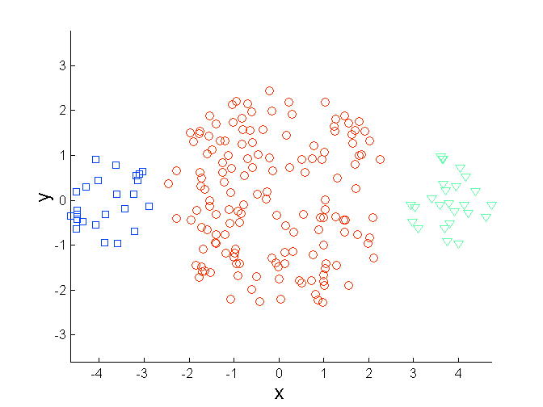
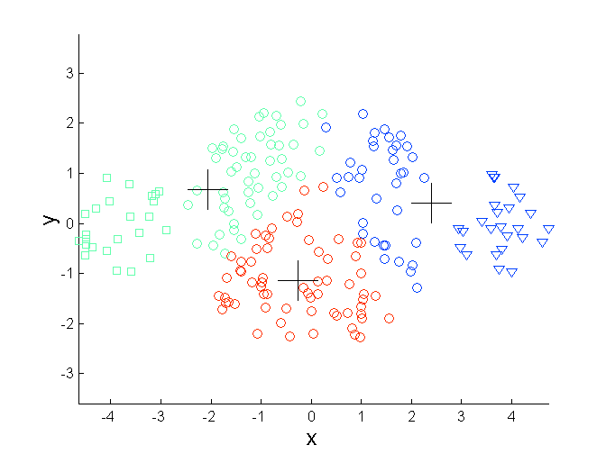
Limitations of K-means: Differing Sizes
Original Points
K-means (3 Clusters)

Slide 53
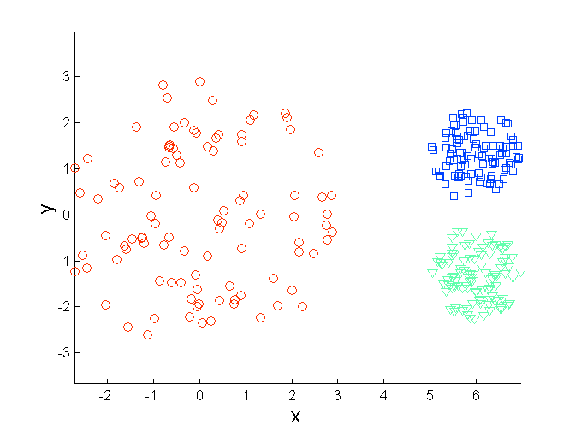
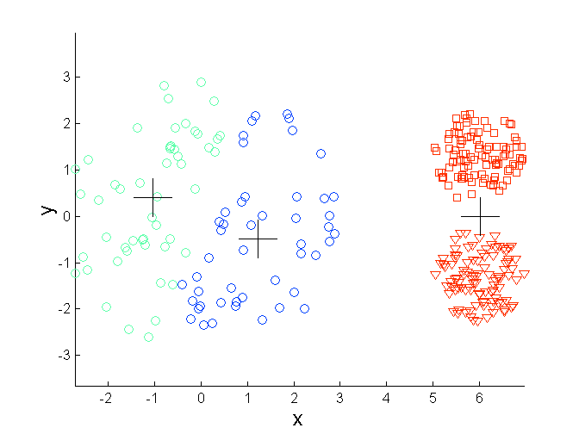
Limitations of K-means: Differing Density
Original Points
K-means (3 Clusters)

Slide 54
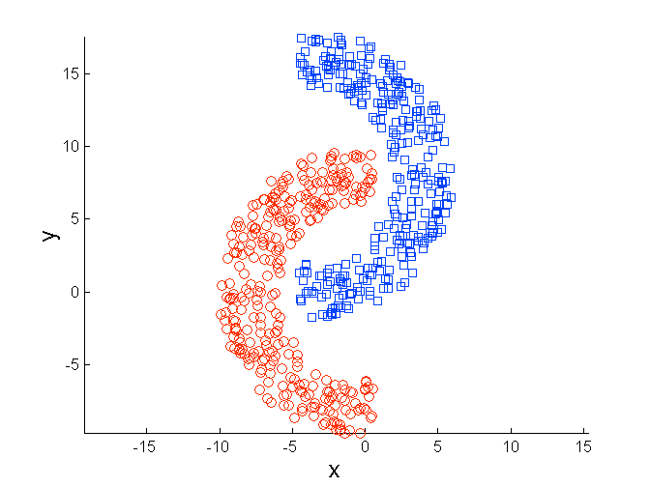
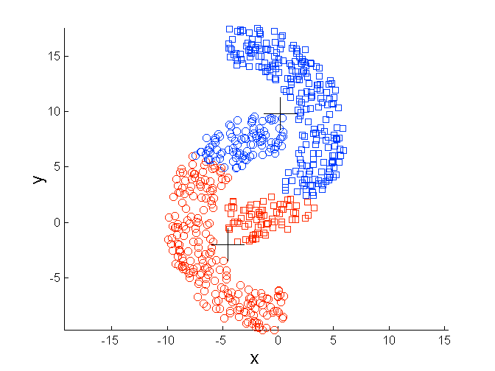
Limitations of K-means: Non-globular and linearly non-separable Shapes
Original Points
K-means (2 Clusters)

Slide 55
Comments on k-Means
Strengths
Relatively efficient: O(tkn), where n is # objects, k is # clusters, and t is # iterations. Normally, k, t << n.
Often terminates at a local optimum.
Weakness
Applicable only when mean is defined, then what about categorical data?
Need to specify k, the number of clusters, in advance
Unable to handle noisy data and outliers
Not suitable to discover clusters with non-convex shapes
Slide based on one by Eamonn Keogh

Slide 56
How do we measure similarity?
Peter
Piotr
0.23
3
342.7
Slide based on one by Eamonn Keogh

Slide 57
A generic technique for measuring similarity
To measure the similarity between two objects, transform one into the other, and measure how much effort it took. The measure of effort becomes the distance measure.
The distance between Patty and Selma:
Change dress color, 1 point
Change earring shape, 1 point
Change hair part, 1 point
D(Patty,Selma) = 3
The distance between Marge and Selma:
Change dress color, 1 point
Add earrings, 1 point
Decrease height, 1 point
Take up smoking, 1 point
Lose weight, 1 point
D(Marge,Selma) = 5
This is called the “edit distance” or the “transformation distance”
Slide based on one by Eamonn Keogh

Slide 58
Edit Distance Example
How similar are the names “Peter” and “Piotr”?
Assume the following cost function Substitution 1 Unit
Insertion 1 Unit
Deletion 1 Unit
D(Peter,Piotr) is 3
It is possible to transform any string Q into string C, using only Substitution, Insertion and Deletion.
Assume that each of these operators has a cost associated with it.
The similarity between two strings can be defined as the cost of the cheapest transformation from Q to C.
Note that for now we have ignored the issue of how we can find this cheapest transformation
Peter
Piter
Pioter
Piotr
Substitution (i for e)
Insertion (o)
Piotr
Pyotr
Pedro
Piero
Peter
Petros
Pietro
Pierre
Deletion (e)
Slide based on one by Eamonn Keogh

